Slide 1
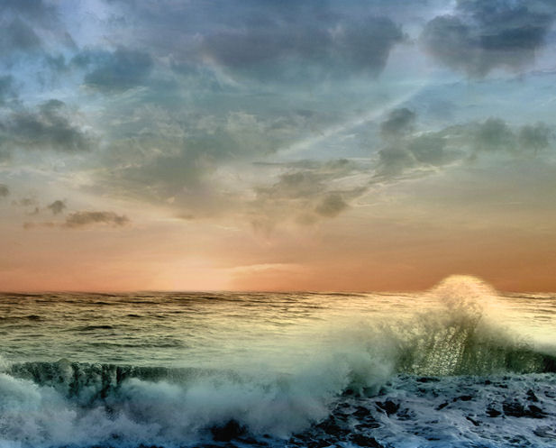
The Integrated Ocean Observing System (IOOS®)
Surface and Benthic Gliders
Dr. Samuel Walker
Integrated Ocean Observing System Program
NOAA, National Ocean Service
November 3, 2010
Notes:
Thank you all for being here today.
The purpose for today’s event is to bring together stakeholders in California concerned with the growing uncertainty of climatic, oceanic, and weather variables.
It is our hope that we can identify new partnerships and opportunities to improve the status of safety, economy, and environment in California and across the Nation.

Slide 2
System
Technology
Applications
NOAA-NWS Technology Summit
Notes:
So what is IOOS?

Slide 3
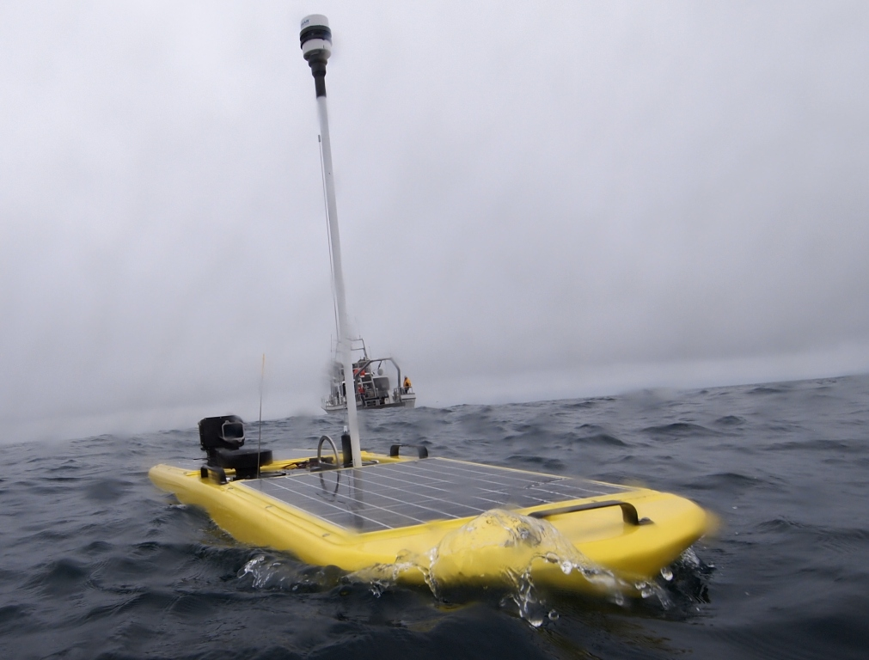
Overview: Benthic and Wave Gliders
Slocum Glider – Teledyne Webb Research
Autonomous
High Endurance
Customized Payloads
Typical Measurements:
  temperature
  salinity
  currents
  chlorophyll
  fluorescence
  acoustic backscatter
  dissolved oxygen
  XYZ, time
Wave Glider - Liquid Robotics®
NOAA-NWS Technology Summit
Notes:
Long-Range Codar SeaSonde® HF Radars

Slide 4
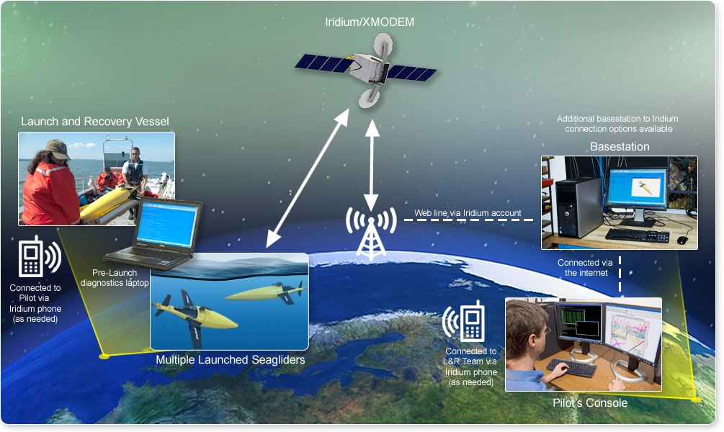
Overview: Glider Communications
Slide courtesy of iRobot®
NOAA-NWS Technology Summit

Slide 5
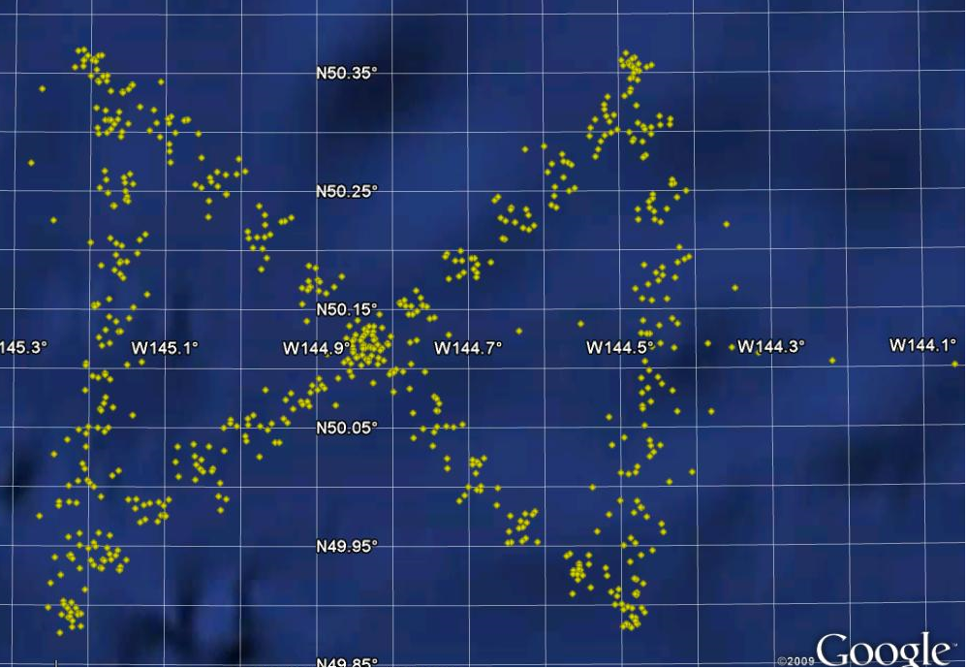
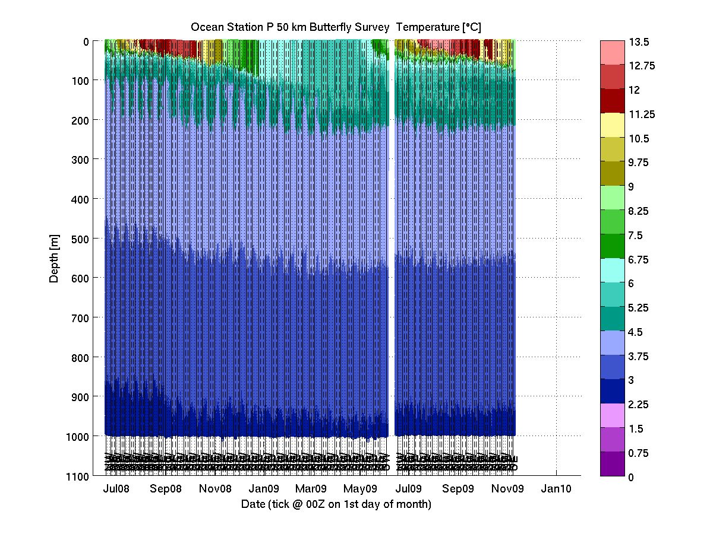
Gliders Provide Decision Support
Ocean State Data for:
Sub-surface Tracking
Model Refinement
Critical Mission Support
Instrument Testing/Validation
Extreme Environment Surveys
HABs and Water Quality
Ocean Acidification
Other Uses:
Map/Quantify Coastal Dynamics
Education and Outreach
Monitoring of Global Events
Biological Monitoring
Craig Lee, University of Washington

Slide 6
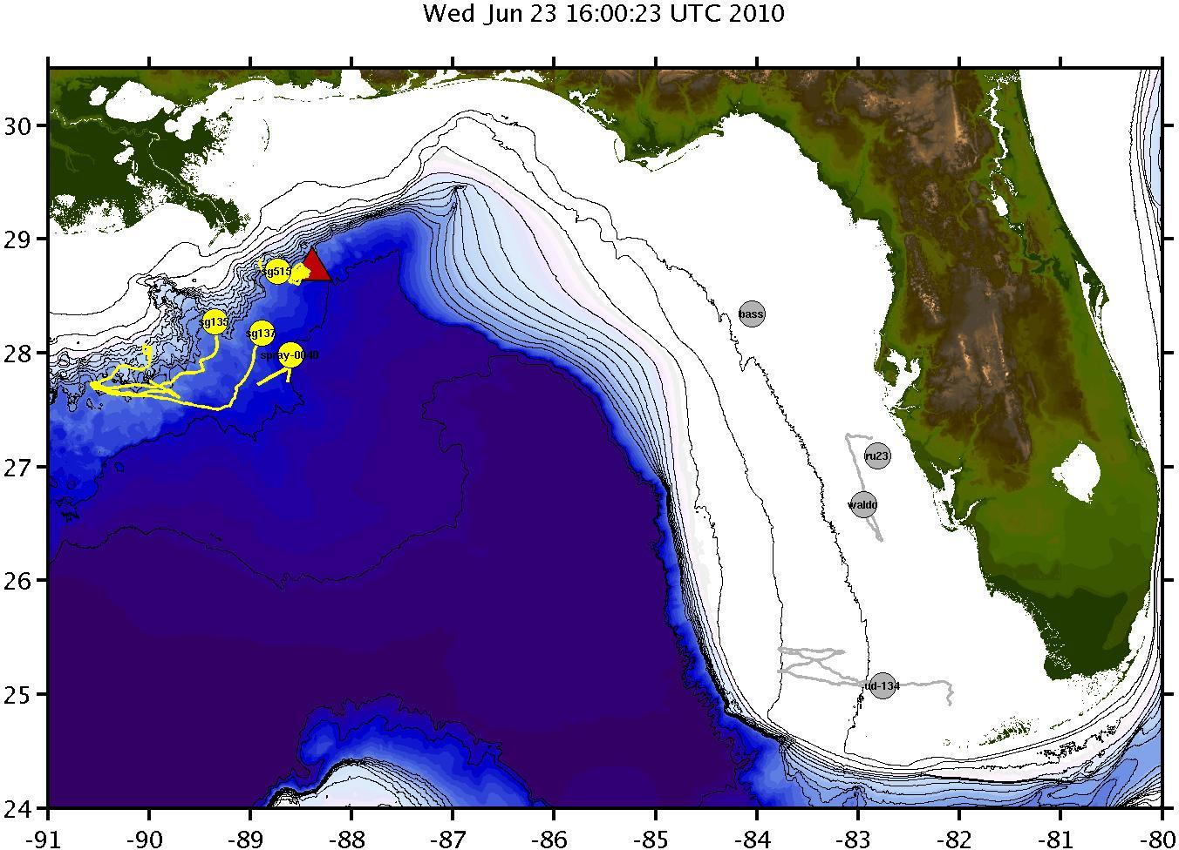
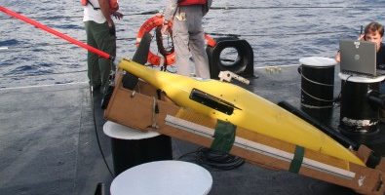
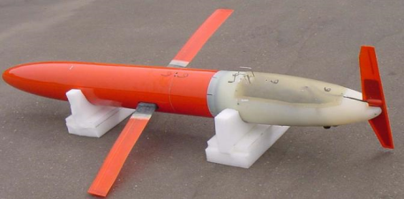
Sub-Surface Monitoring for DWH Spill
Slocum Glider – Teledyne Webb Research
http://rucool.marine.rutgers.edu/deepwater/
SeaGlider- IRobot®
9 Federal/Non-Federal gliders provided critical ocean state data
Served as sentinels to evaluate cross-shelf transport of hydrocarbons
Over 41,000 “casts” since 17 May.
MACOORA (Rutgers (2 gliders), U. Delaware); SECOORA (USF, Mote Marine Lab); GCOOS (USM/iRobot/U. Washington); SCCOOS; US Navy (2)
Spray Glider - Scripps
NOAA-NWS Technology Summit
Notes:
Long-Range Codar SeaSonde® HF Radars

Slide 7
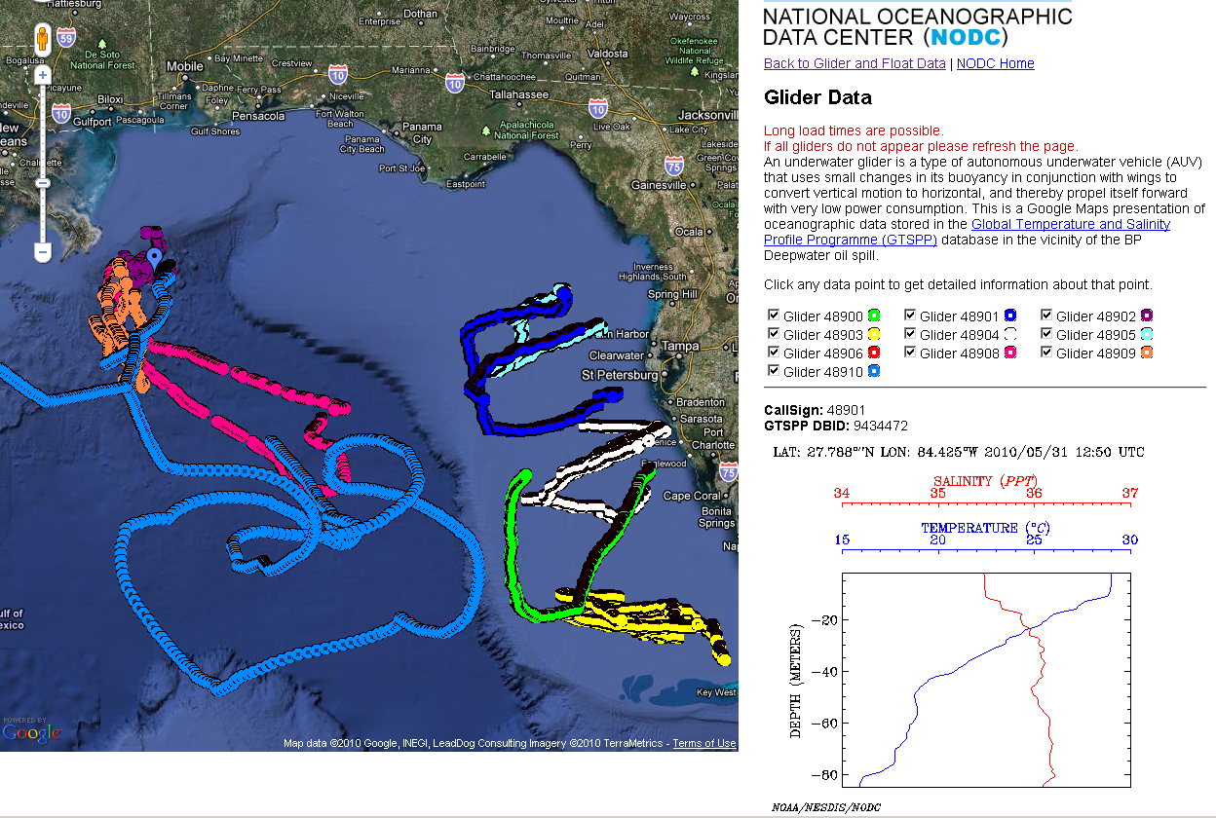
–
Sub-Surface Monitoring for DWH Spill
Over 40,000 observations acquired over 4+ months of DWH spill response.
http://www.nodc.noaa.gov/General/DeepwaterHorizon/support.html
NOAA-NWS Technology Summit
Notes:
Over 40,000 observations collected
Available for modeling teams
Sentinel mode for sub-surface hydrocarbon presence
Ideal for Shelf and Loop Current locations

Slide 8
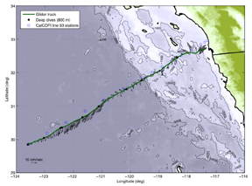
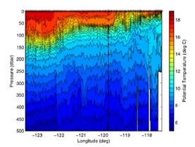
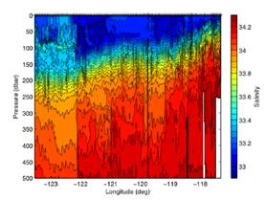
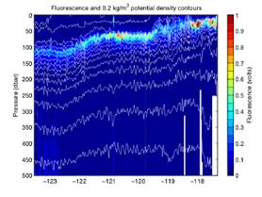
Typical Glider Operations
Continuously monitors coastal velocity, temperature, salinity, and phytoplankton
SCCOOS gliders are able to profile from the
surface to 500m and back in 3 hours, while
moving horizontally 3 km
Macro-, meso-, and micro-scale features can be resolved by the glider continuously
SCCOOS
NOAA-NWS Technology Summit

Slide 9
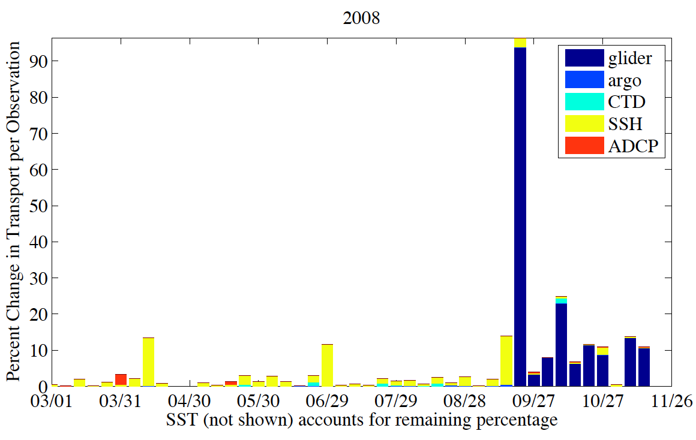
Impact of Glider Data on Models
The bars show the percentage of the correction to the original model estimate comes from different data source
SST (the white areas) contributes the most as they consistent of thousands of observations over the entire domain
When a glider is operating it is the largest contributor next to SST
Brian Powell, PACIOOS
NOAA-NWS Technology Summit
Notes:
Attached is an image you'll be able to use. We presently have 1 glider owned by PacIOOS but also rely on other gliders owned by the School and other programs.
For PacIOOS we have had 2 missions in 2010 (as we go round in circles I haven't been tracking miles flown)
Mission 1 (SG139): 12-Apr-10 to 14-Jul-10; 94 days; 749 dives
Mission 2 (SG139): 27-Jul-10 to present; to date 78 days and 668 dives.
Also using other NOAA money (from Bruce Howe and Jef Polovina) we have flown 2 acoustic glider missions
Mission 1 (SG500): 16-Jun-10 to 05-Aug-10; 50 days; 213 dives
Mission 2 (SG500): 15-Sep-10 to 12-oct-10; 27 days; 218 dives
And Dave Karl's CMORE group has one on-going mission this year
Mission 1 (SG146): 13-Jul-10 to present; to date 92 days and 403 dives.
Attached is a figure from Brian Powell looking at the impact of the gliders on the HiOOS ocean model (prior to this year). Recent analysis by Brian Powell of the impact of assimilating various data types on the model output showed that the glider data (when it exists) has a significant impact (Fig. 1). The bars show the percentage of the correction to the original model estimate comes from different data source. Most of the the SST (the white areas ) contribute the most as they consistent of thousands of observations over the entire domain. When a glider is operating it is the largest contributor next to SST. The glider is the only measure of temperature and salinity below the mixed layer. The initial spike when the glider is launched, is the model correcting to these deep values. After that model’s initial estimate remains more in agreement with the glider data (hence the apparent decreasing influence). When the glider is in the water, it contributes 1.5% of the data the model assimilates but over 10% of the information used in the correction.

Slide 10
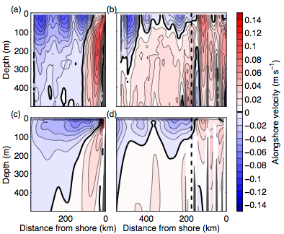
Model Calibration/Validation
Data-assimilating numerical simulation for 1 Jan 2007-30 July 2009
Incorporates glider, ship, satellite, mooring, and float data
Mean velocity fields agree well with glider observations
(above) Mean alongshore velocities from (a,b) glider observations, and (c,d) numerical simulation along CalCOFI Lines (a,c) 80.0, and (b,d) 90.0. Positive velocities are poleward.
SeaGlider- IRobot®
NOAA-NWS Technology Summit

Slide 11
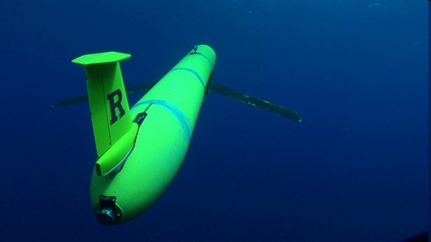
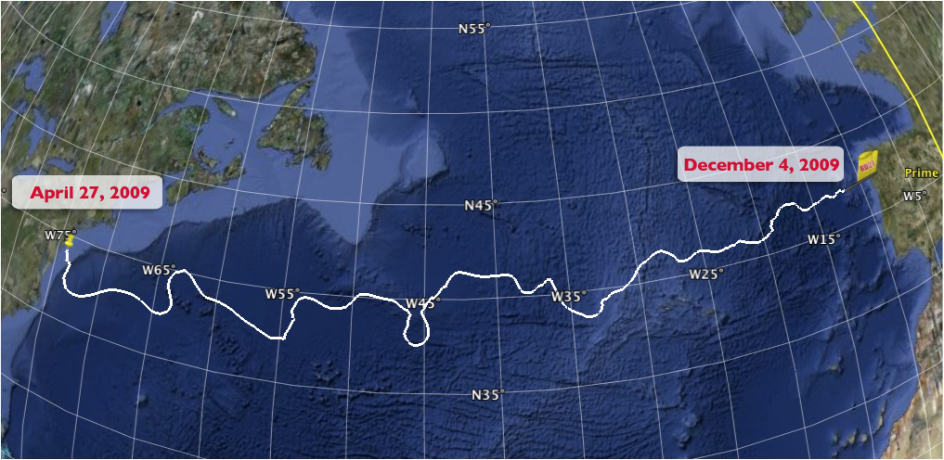
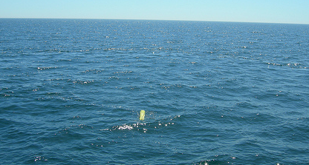
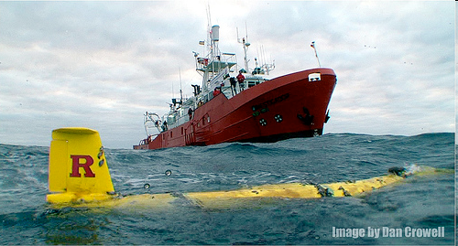
Rutgers’ Scarlet Knight Crosses Ocean Basin
221 Days
7,409 km
11,000 Dives
11,000 Climbs
Energy equivalent of 8 minutes power the Rockefeller Center Tree
Tuckerton, New Jersey, USA
Baiona, Galicia, Spain
NOAA-NWS Technology Summit

Slide 12
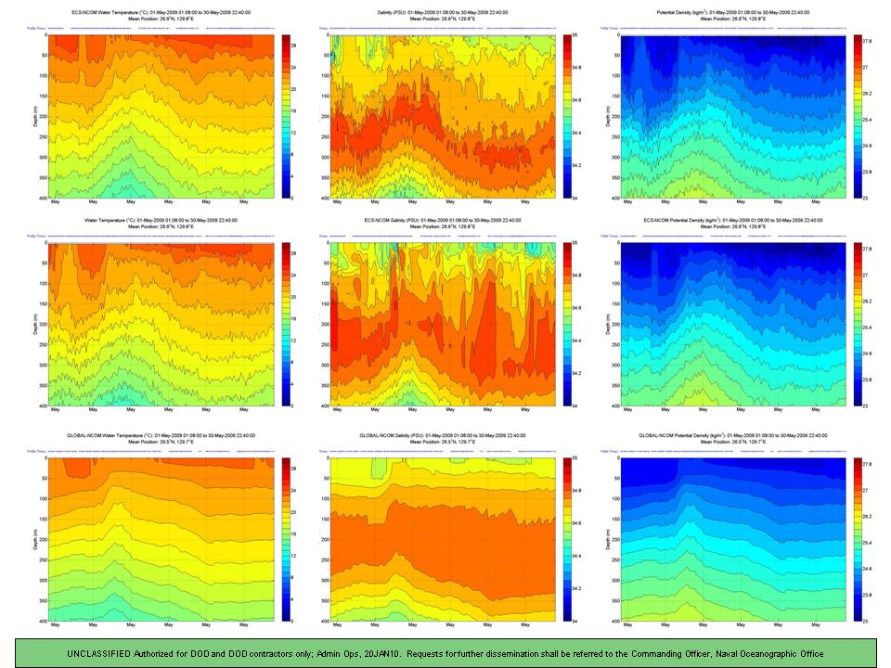
Time Series of Glider Profiles & Global & Regional NCOM Forecasts of Temperature, Salinity, Potential Density
Temperature Salinity Potential Density
Glider
WPAC
Global
Top – Seaglider CTD observations for the period 01-30 May 2009
Center – 1/36 Degree Regional WPAC-NCOM concurrent profile data
Bottom – 1/8 Degree Global NCOM data
Glider passed through a cold-core eddy
Regional NCOM includes tides
  GNCOM does not
  Note presence of internal tides
  RNCOM does amplitude well
  We need to work on phase
Profile Analysis Viewing Environment (PAVE) , Mike Toner, NAVOCEANO
NOAA-NWS Technology Summit

Slide 13
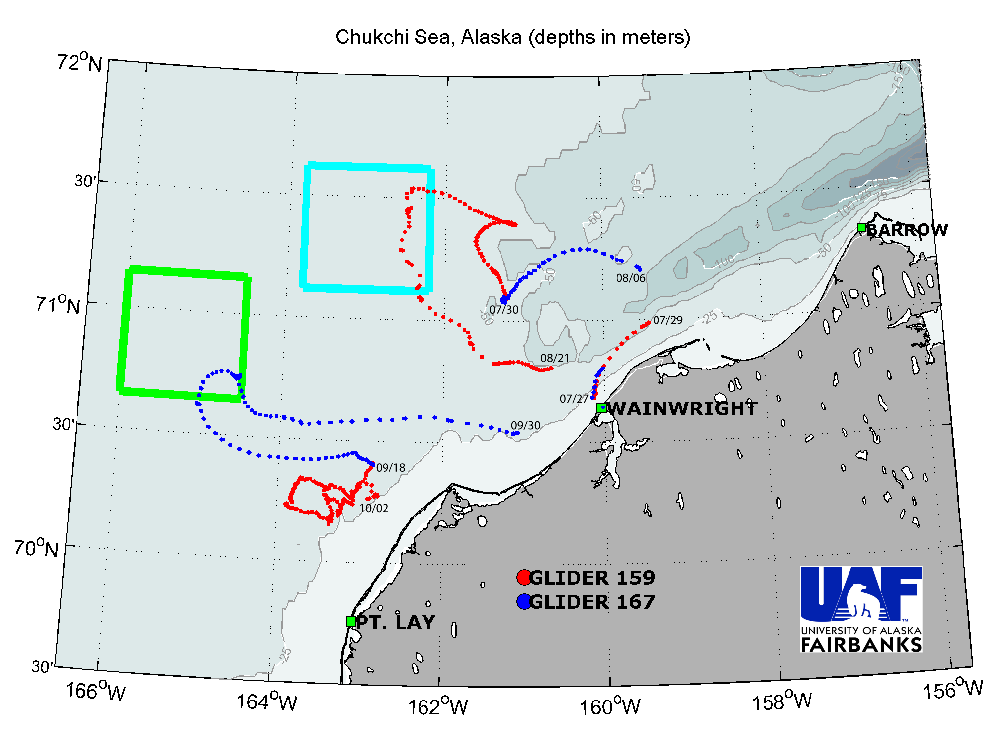
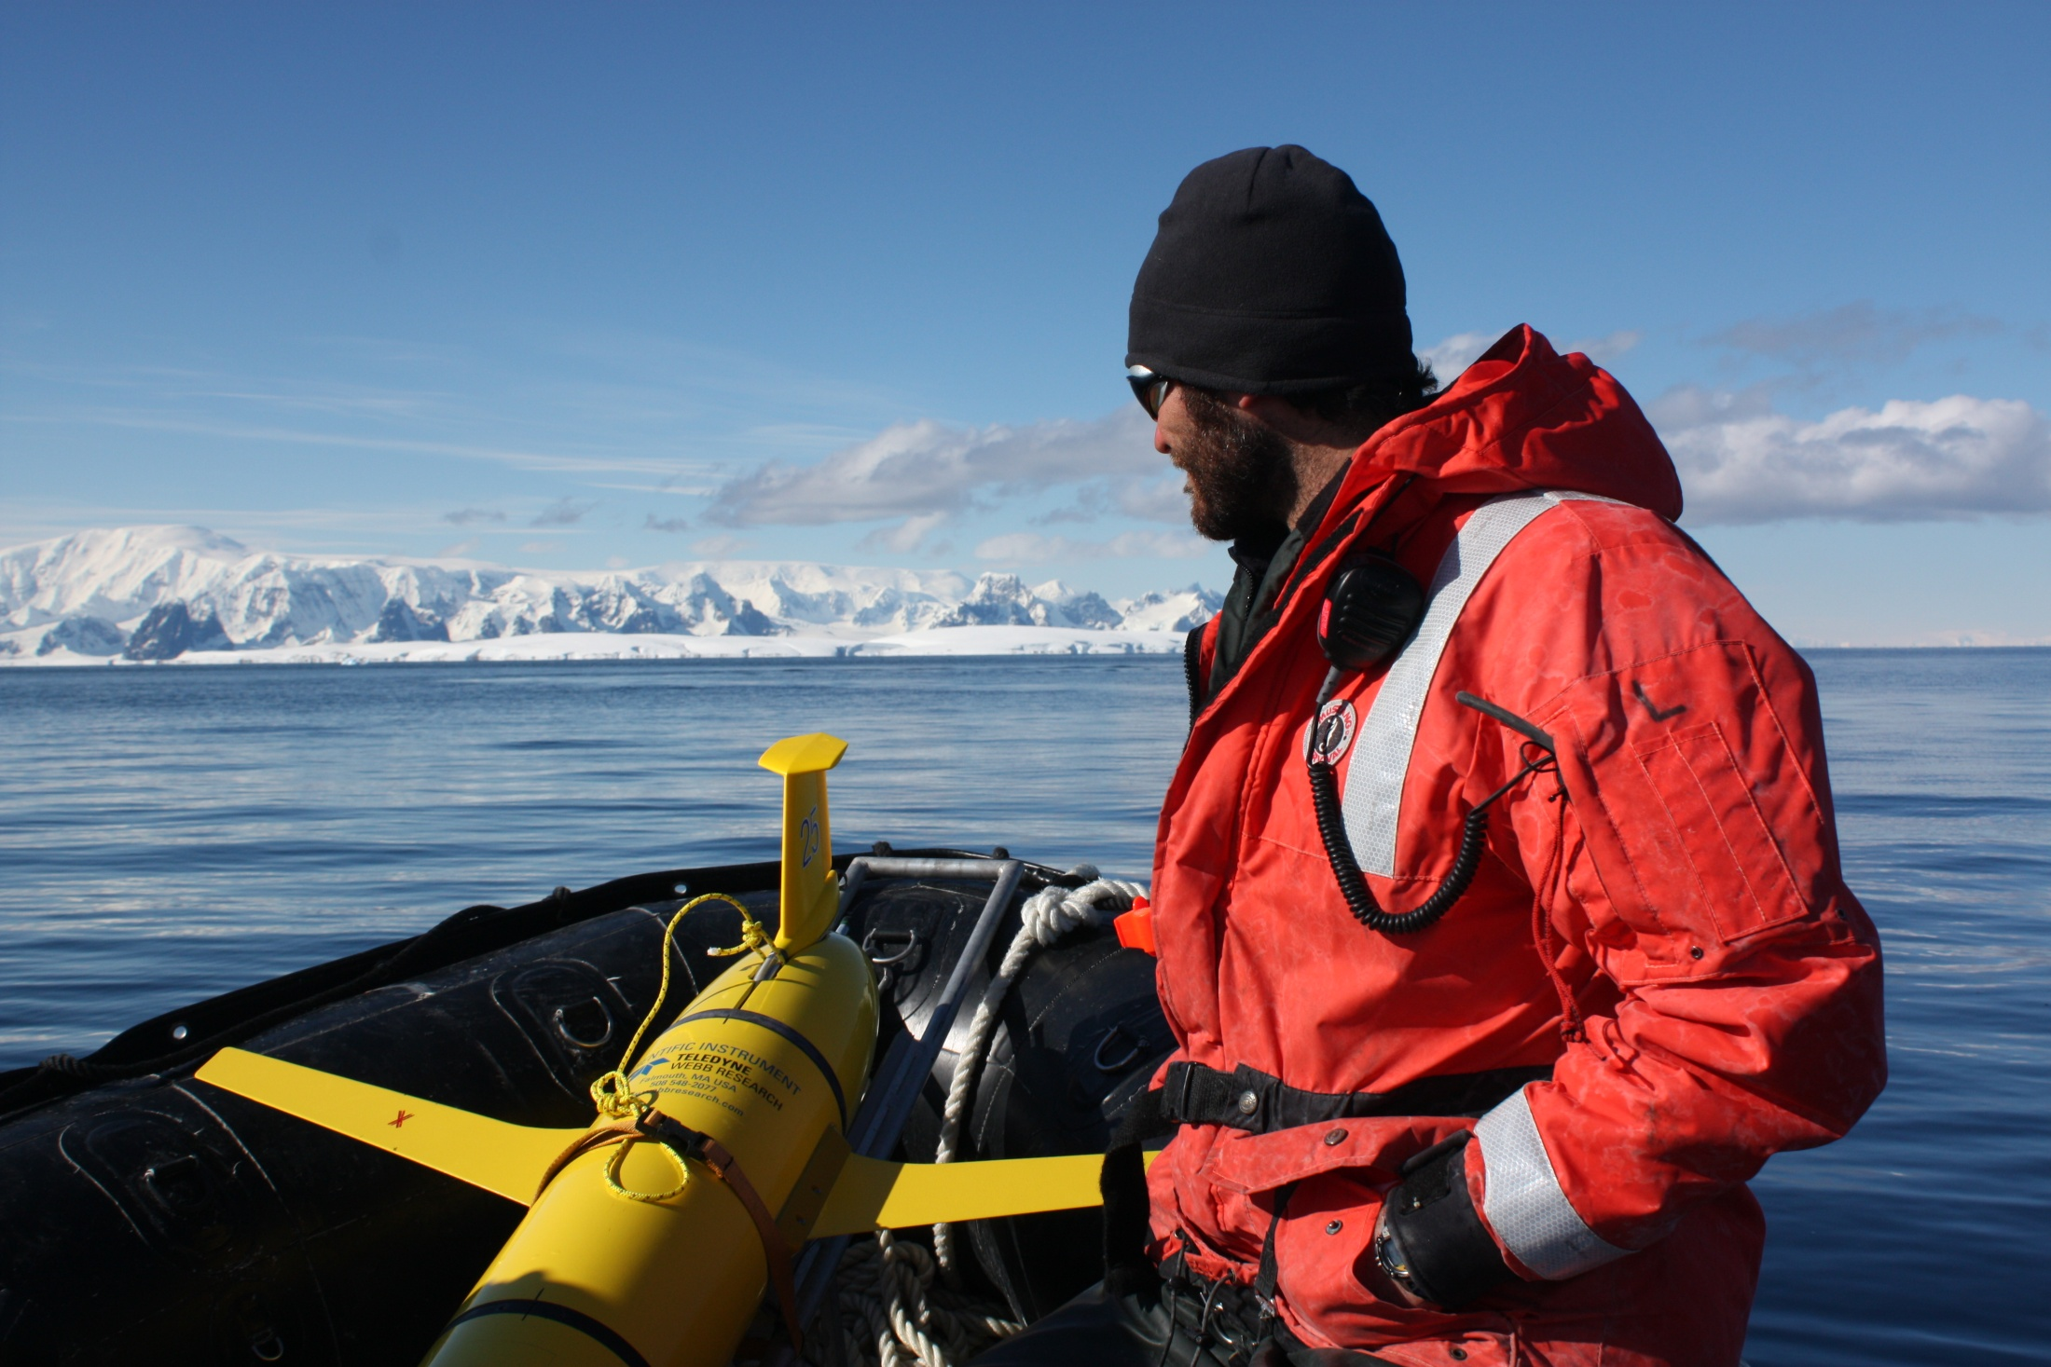
2010 UAF Arctic Glider Missions
69 days of glider missions
>800km covered
>3000 vertical profiles
Webb Slocum gliders (2)
Dynamics of polar oceans
Operates in extreme environments
Enhanced safety of personnel
Supports critical research missions
PIs: Peter Winsor & Tom Weingartner, UAF
NOAA-NWS Technology Summit

Slide 14
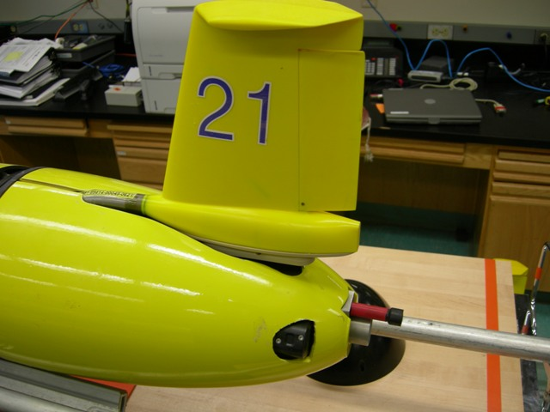
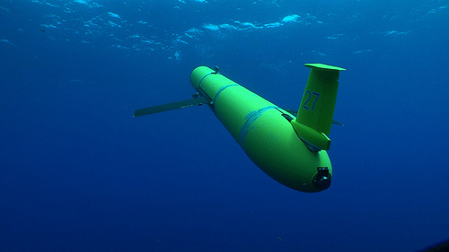
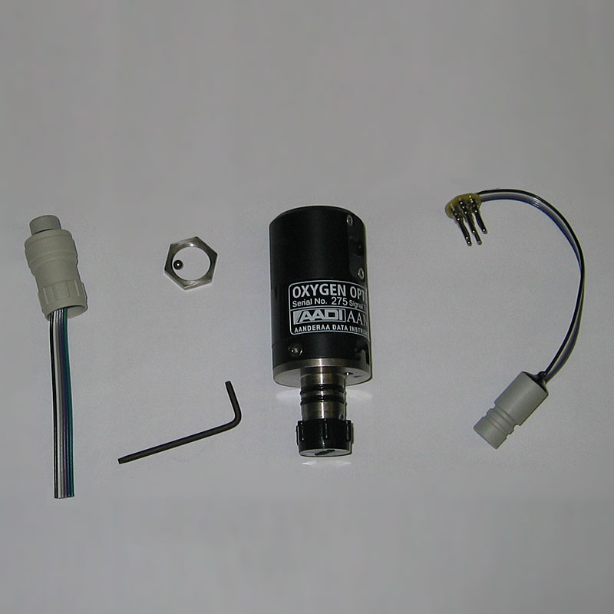
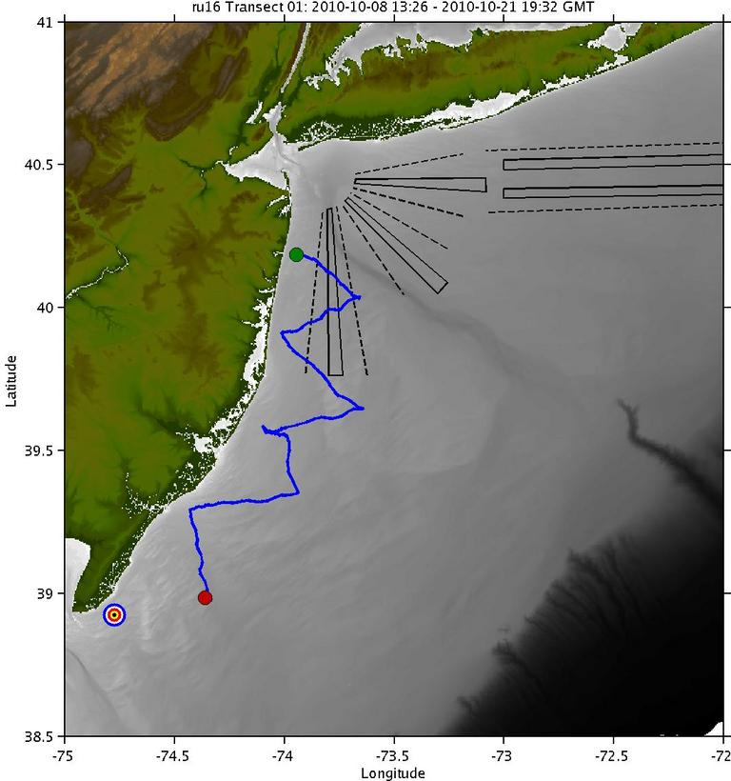
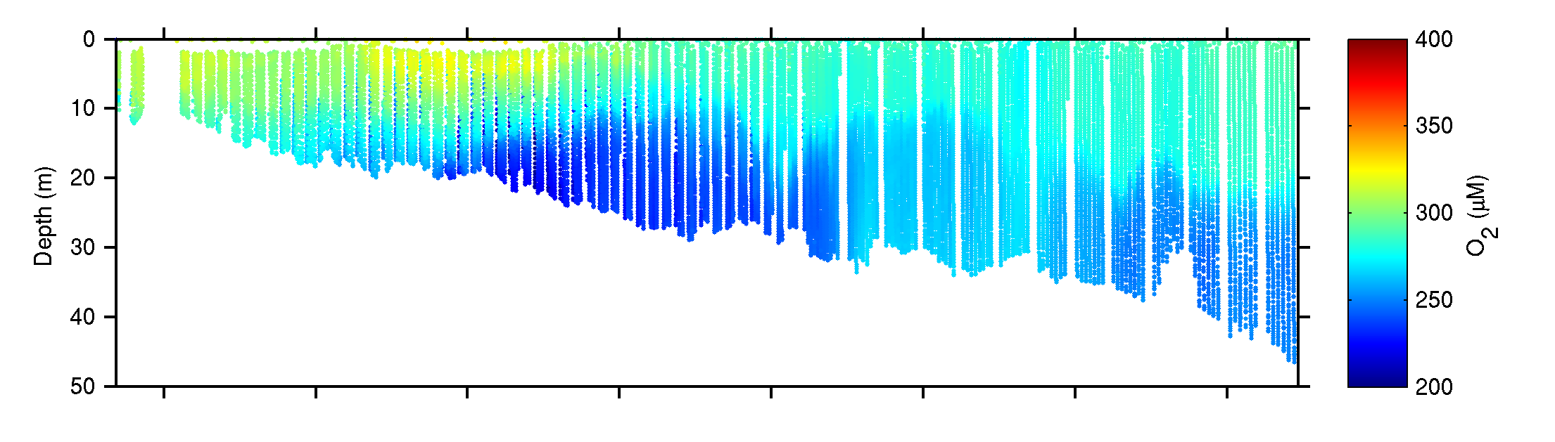
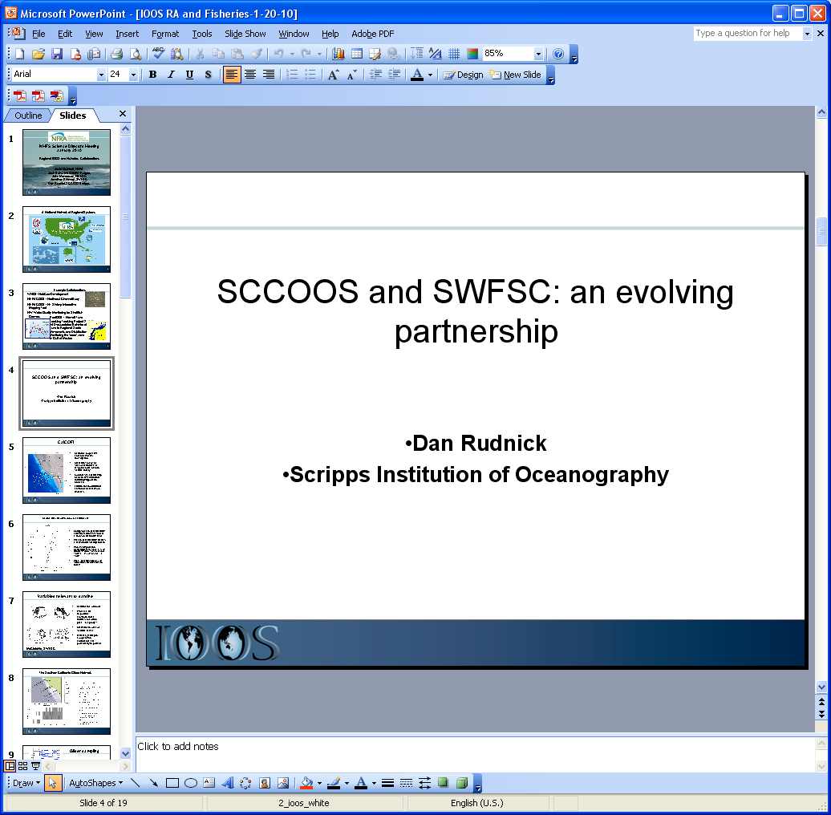
Autonomous, Continuous Measurements
Oxygen Concentration
NJDEP, EPA, Rutgers, MACOORA
NOAA-NWS Technology Summit
Notes:
Slide 8: Shows the work we are doing with NJDEP and EPA to fly near shore glider missions to monitor dissolved oxygen. WE did one flight last year and are just finishing the second of three missions funded for this year. All this data is going to stevens for assimilation into their model.

Slide 15
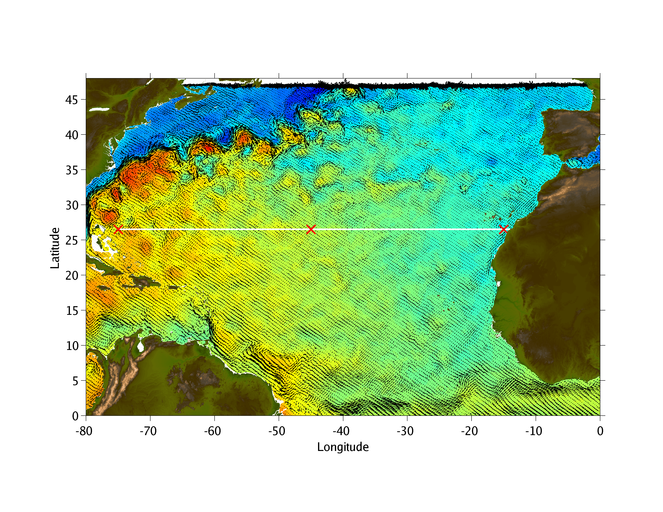
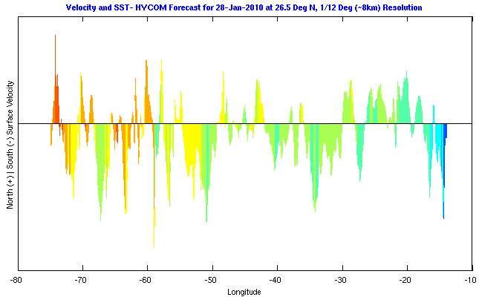
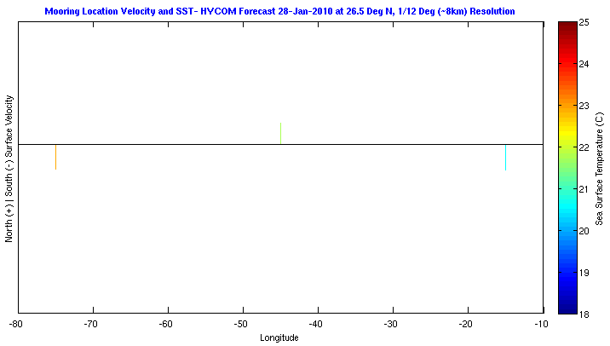
Comparison of Inputs to HYCOM Model
Glider & Buoy Sampling Regimes (26.5 N Latitude)
10 Glider Fleet
3 Buoy Array
NOAA-NWS Technology Summit

Slide 16
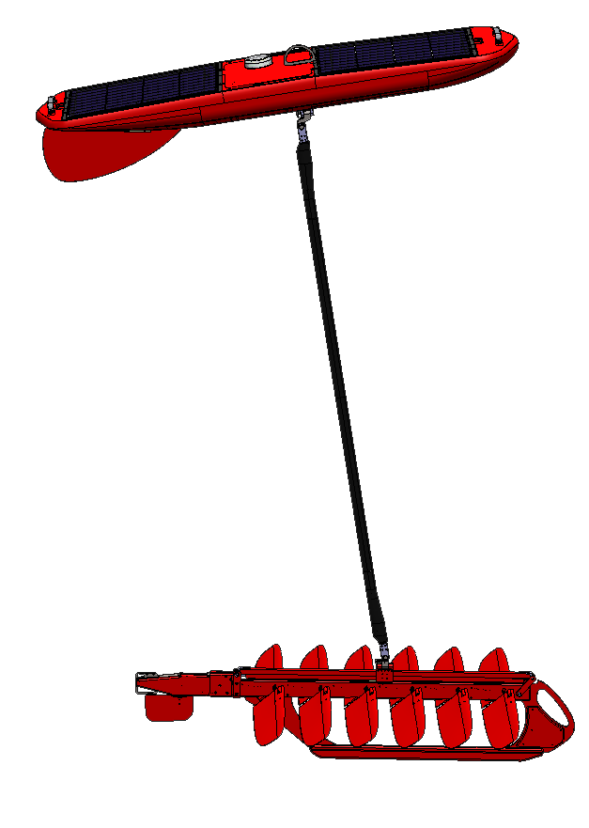
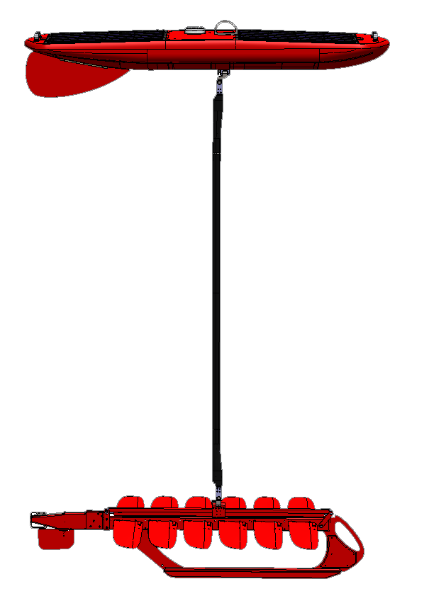
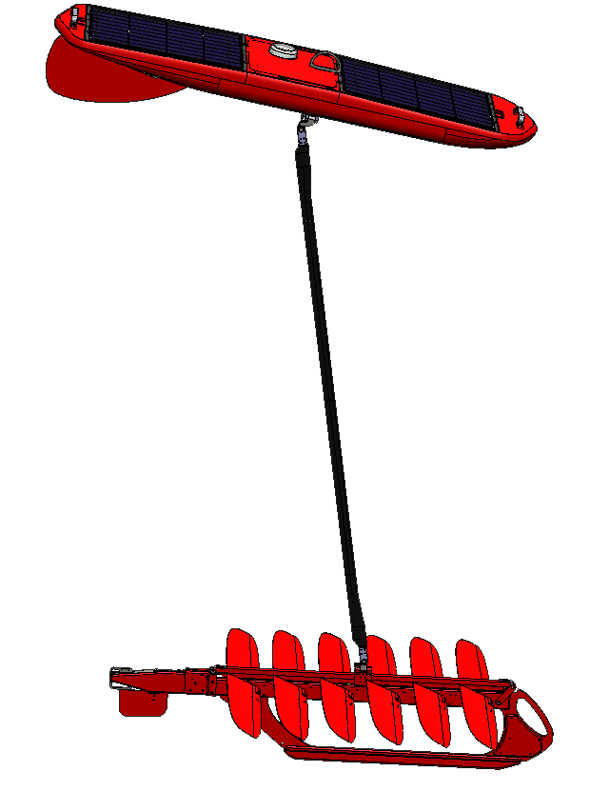
Wave Glider Concept
7m
Fins
2m
Both upward and downward motions produce thrust
A rudder at the tail of the glider steers the vehicle in any direction
NOAA-NWS Technology Summit

Slide 17
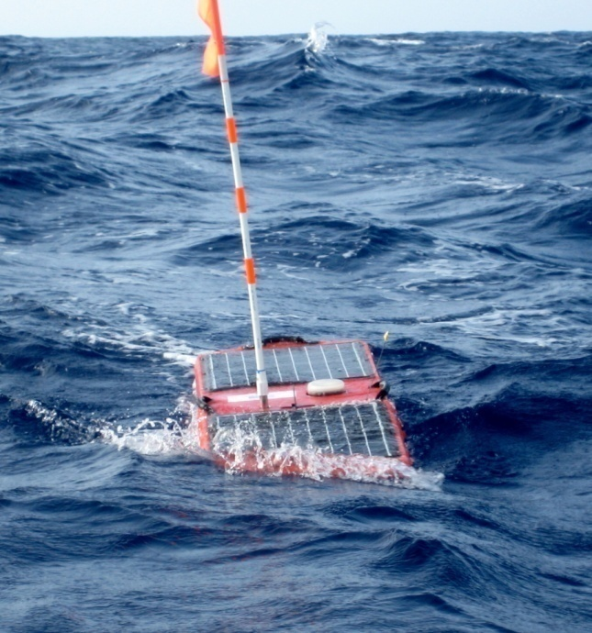
Wave Glider Basics
Unique Two Part Vehicle:
  Converts wave motion into thrust
  Calm and rough seas
  Thrust increases with sea state
  Long mission durations possible
Both a Platform and a Vehicle:
  Travel to operation area
  Return for maintenance
  Patrol, survey or hold station
Operational:
  Fleet has traveled over 60,000 nmi
  Distance of longest mission, 6200 nmi
  Duration of longest mission, 365 days
NOAA-NWS Technology Summit

Slide 18



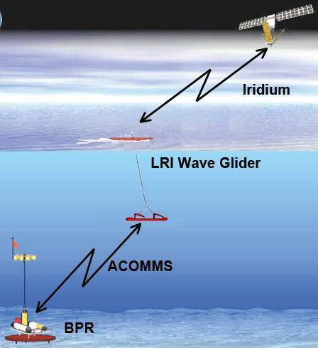
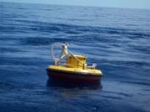
Critical Mission Support
NOAA DART Buoy Test:
Provided redundant communications with bottom mounted sensor
DART buoy 51407 off Kona coast
Transited with glider based payload
Station-keeping demonstrated
UNCLASSIFIED//FOUO
NOAA-NWS Technology Summit
Notes:
18
18

Slide 19
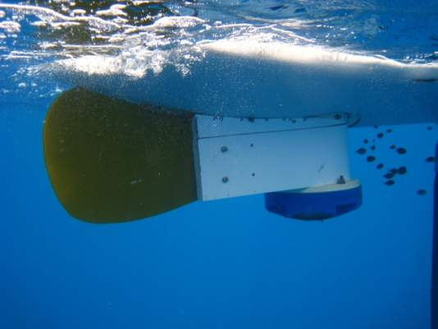
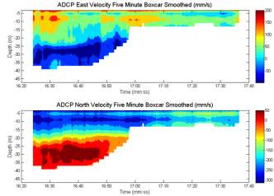


Supporting Instrument Trials
Successful system integration, Teledyne RDI 600 kHz Sentinel
Series of tests to evaluate the ADCP performance and data quality
Data below the glider validated
Surface layers between the float and glider have high resolution
NOAA-NWS Technology Summit

Slide 20

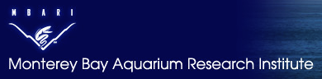
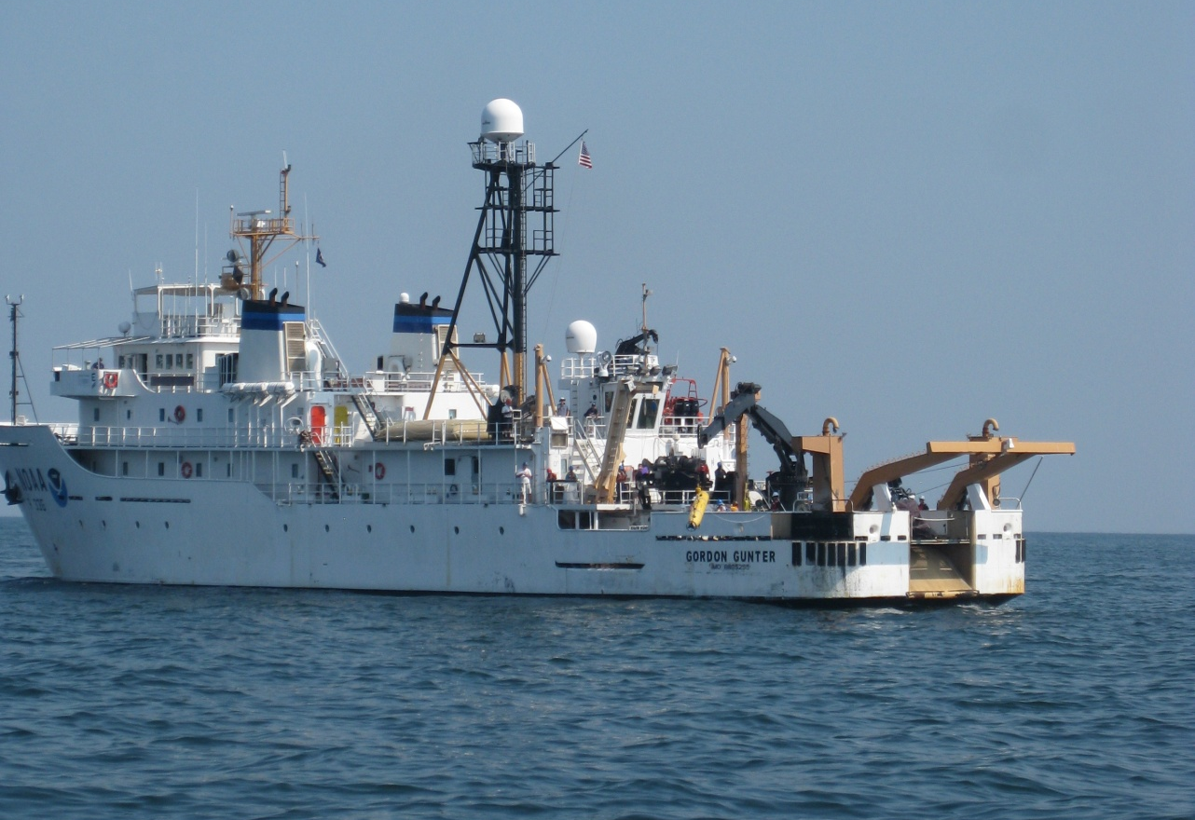
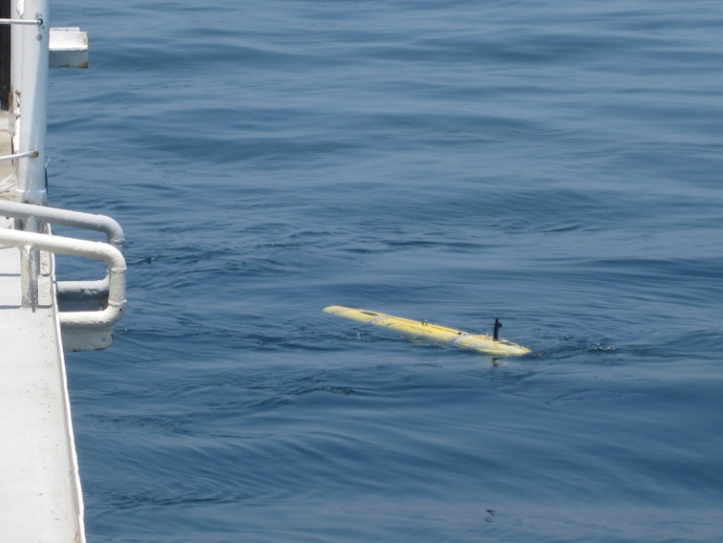
Other Specialized Glider Configurations
MBARI Gulper:
Hybrid AUV-Glider
Deployed for DWH
Capable of Sample Capture
Carries Sensor Payload
MBARI Gulper being deployed from NOAA Ship Gordon Gunter in support of Deepwater Horizon response
Notes:
Long-Range Codar SeaSonde® HF Radars

Slide 21
Summary of Costs and Specifications
Benthic Gliders:
Cost: $120K-$180K
Cost of 1 month of operation: ~$20-30K (inclusive)
~8-10 Dives/Day
~ 1-2 knots
Vertical range of ~1000m (opportunity for R&D?)
Compare to 1 month of ship time…
Wave Gliders:
24/7, multi-month missions
<$400/day to operate
Slocum Glider specifications
  Length: 1.5m, hull Diameter: 21.3 cm; Weight: 52 kg
Science Bay Specifications:
  Length: 30 cm, Diameter 21.3 cm; Payload Weight: 4 kg
Notes:
Long-Range Codar SeaSonde® HF Radars

Slide 22
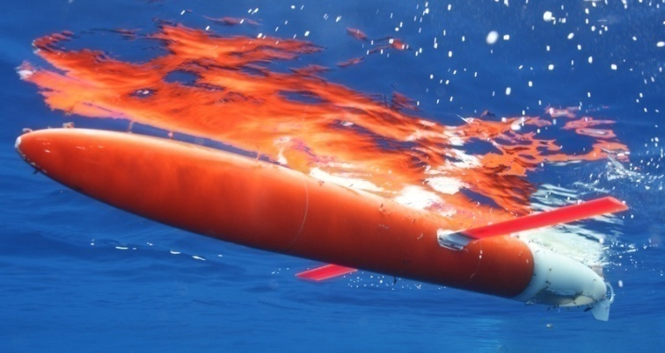
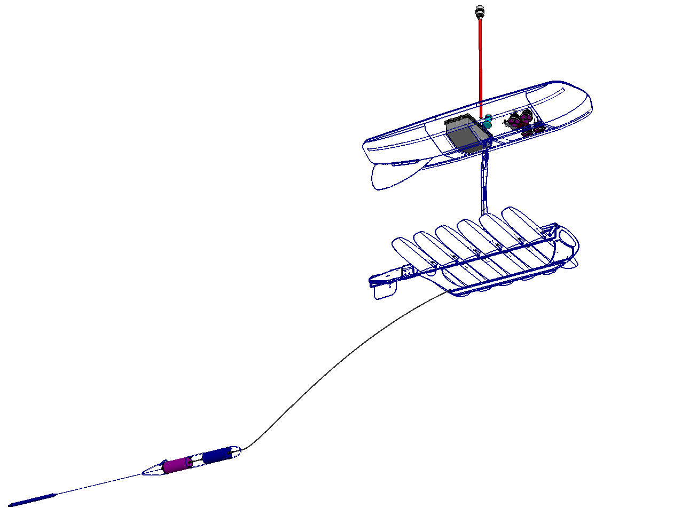
IOOS® Gliders: Summary of Benefits
Autonomous
NRT Data Relay
Versatile Platform
High-endurance
Programmable/Mobile
Custom Payloads
Cost-Effective
Non-Invasive
Model Cal/Val
Testing/Comparison
Extreme Missions
Education & Outreach
R&D Opportunities
A Spray glider on the surface.
Photo by Robert Todd, SIO.
Schematic of Wave Glider
Courtesy: Liquid Robotics
Notes:
Long-Range Codar SeaSonde® HF Radars

Slide 23
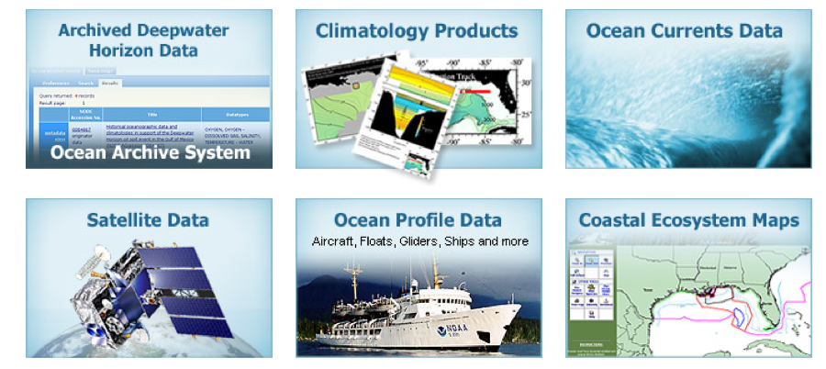
Questions and Discussion
http://www.ioos.gov
IOOS Program Director:
Zdenka Willis (zdenka.s.willis@noaa.gov)
Dr. Sam Walker (sam.walker@noaa.gov)

Slide 24
Excess Slides for Discussion

Slide 25
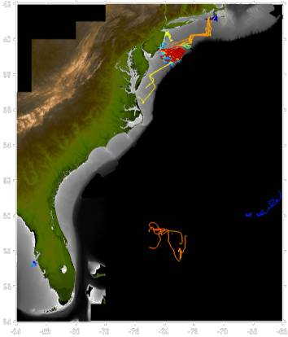
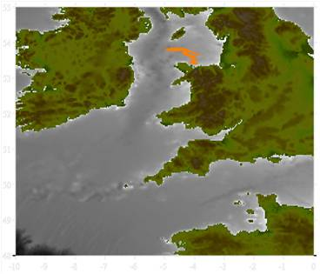
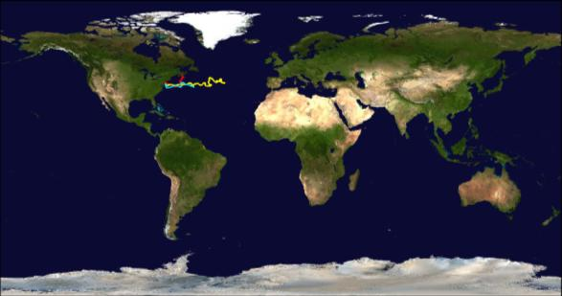
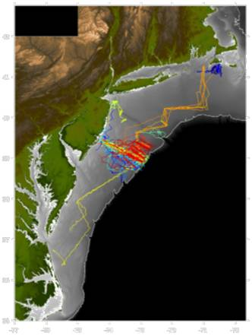
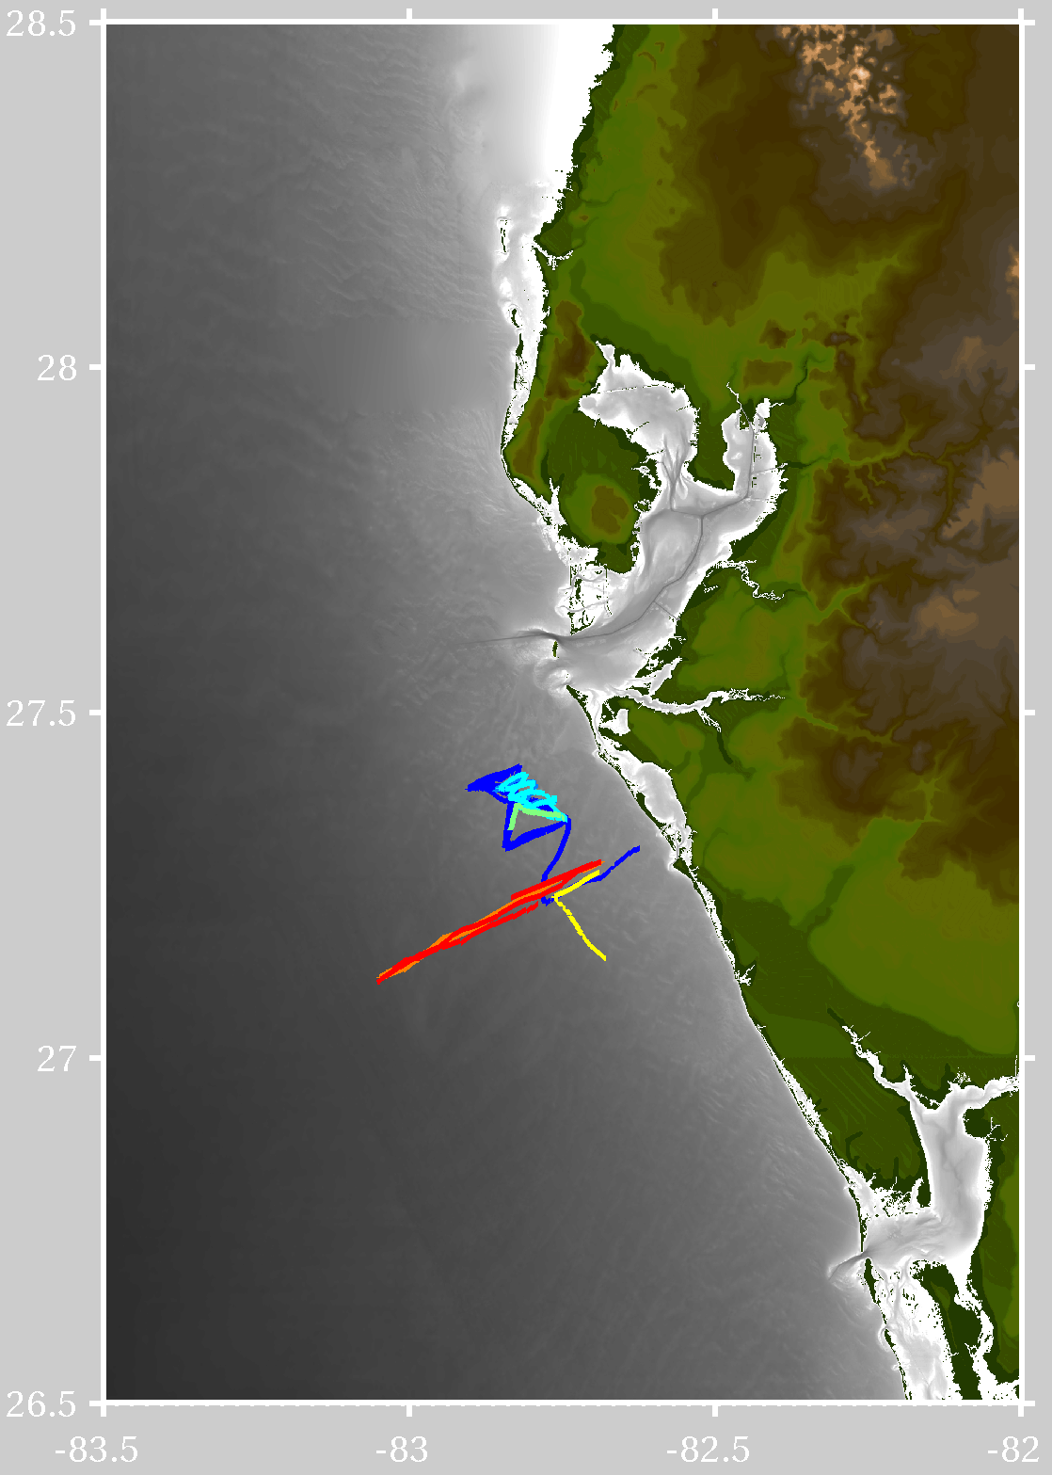


US IOOS Partner Glider Fleet
164 deployments worldwide (Oct. 2003 – Jul. 2009)
Over 62816 km (Earth’s circ. ~ 40,000 km)
2800 days at sea, 378671 profiles
Liverpool Bay
Coastal Observatory
IMCS CODAR support
IMCS glider support
Mid-Atlantic Shelf
West Florida
Shelf
Mediterranean Sea
Perth, Australia

Slide 26


Weather Station
Long Term Environmental Monitoring
For Gulf of Mexico
Water Quality
Marine Mammal Acoustics
MetOcean Data
FLOAT
Fluorometer set
GLIDER
Hydrophone
Fluorometer set
© Liquid Robotics: For NOAA Use Only
Notes:
This is the conceptual layout of the “loaded” configuration. That includes the hydrophone package. The trial deployment is two vehicles like this and two more with just fluorometers and weather station. Details on the fluorometers and weather station:
1) Fluorometer Type 1, "Refined fuel": detects volatile organic compounds (VOC) including benzene, toluene, ethylbenzene, xylene (BTEX)http://www.turnerdesigns.com/t2/instruments/C3.html
2)Fluorometer Type 2, "Crude Oil": detects a broad range of of dissolved oil compounds or emulsions (NOTE: also sensitive to air bubbles and materials other than crude oil) http://www.turnerdesigns.com/t2/doc/appnotes/oil.html
3) Fluorometer Type 3, CDOM: detects Colored Dissolved Organic Matterhttp://www.turnerdesigns.com/t2/doc/appnotes/cdom.html
4) Fluorometer Type 4, Chlorophyll A In-Vivo: detects phytoplankton or algaehttp://www.turnerdesigns.com/t2/doc/appnotes/algal.html
5) Turbidity: detects optical backscatter, a standard measure of water clarityhttp://www.turnerdesigns.com/t2/doc/appnotes/turbidity.html
6) Water Temperature: Measured by thermocouples in C3 fluorometer moduleshttp://www.turnerdesigns.com/t2/instruments/C3.html
7) Air Temperature, Barometric Pressure, Wind Speed and Direction, http://airmartechnology.com/2009/products/marine-product.asp?prodid=105&manf=

Slide 27




HMS Challenger Mission – 1872-1876
First Dedicated Global Ocean Science Cruise
Can a globally distributed network of early career scientists & students repeat the Challenger Mission with a coordinated fleet of underwater robotic gliders?
2012 - ????

Slide 28



















Autonomous Underwater Gliders
RU COOL 20+ Glider Fleet:
January 2003 - May 2010
180 deployments
75,000 km flown
1,741 calendar days at sea
3,431 in-water days

Slide 29


Test Missions
Circumnavigation of Hawaii, January 9-19 2009
West Coast Mission
Onboard weather sensor data compared favorably against existing weather buoys
Encountered 40 knot winds and 6.1 meter waves
Distance: 1300 nm; Duration: 41 days; AvgSpeed: 1.5 kts
Distance (route): 307nm
Distance (travelled): 343nm
Duration:9 days, 2 hours
Average Speed: 1.57kts (SOG)
Max Speed: 3.84kts (SOG)
Sea State (WMO): SS5 [est10ft, 15kts]
Unclassified//FOUO
NOAA-NWS Technology Summit

Slide 30
An Innovative Observational Network for Critical Arctic Gateways – Autonomous Gliders
Mission goals
  Connect Arctic and subpolar oceans
  Understand decadal scale climate variability
Missions Provide
  High-resolution wintertime sections and demonstrating system capability
  Valuable data for refining under-ice autonomy
  Understanding mid-frequency sound propagation in ice covered environments.
Development includes
  Refinements to under ice capabilities
  Acoustic communications to enable data transfer
  Integration of new sensors
  Enhanced endurance, with the goal of operating from one ice-free season to the next without servicing.
Notes:
Sea Gliders were deployed in 2005, 2006, 2007 and 2008 to complement the array deployed across the Davis Strait between Baffin Island, Canada and Greenland. The initial array deployment occurred in September 2004. The initial array consisted of moored and bottom mounted elements. In the most recent deployments, all elements have been moved onto moorings to reduce bottom related fouling. As expected at the outset of this effort, the strait has proven to be a difficult environment for gliders due to remoteness and ice. In addition to ice related difficulties, the remoteness of the strait means that even when more typical problems occur in open water, recovery operations are difficult.
SG109 made the first successful under ice section across the strait in December 2006. From the ice edge on the eastern side of the strait the vehicle navigated to a waypoint 50 km west under ice and back east again over the course of one week. Unfortunately the vehicle was lost shortly after this achievement. The failure mode is unknown.
SG108 and SG113 were launched in September 2008 during the yearly array servicing cruise. Both functioned successfully to the start of the icing period in mid-November. On November 15, SG108 went under the ice on the eastern side of the strait for the first of two successful cross-strait transects. Due to strong currents along the Baffin slope the glider was pushed south off the line survey line in both cases and had to work its way back to the northeast to the eastern end of the line. The return trip followed the ice edge in some cases and thus the glider was in and out of ice cover during this period. In February 25, 2009 the glider was recovered by the Danish Navy after successfully transiting from the survey region to a recovery point off Nuuk, Greenland. Red positions indicate GPS navigation fixes (and thus periods or dive when there was open water), blue indicates RAFOS acoustic fixes (periods or dive when the glider was under ice and unable to come to the surface) and green are interpolated positions indicating that the glider was under ice and did not have a recent acoustic navigation solution.
Long-endurance, autonomous gliders developed at the Applied Physics Laboratory, University of Washington, have seen successful operation in an ice-covered environment, occupying a section across the wintertime Davis Strait. Gliders profile between the surface (or ice-ocean interface) and 1000 m, navigating between waypoints using GPS whenever they can access the surface, or by trilateration on an array of long-range acoustic navigation beacons when overhead ice prevents surfacing. In addition to temperature, salinity, and dissolved oxygen sensors, gliders can carry a variety of optical sensors for measuring fluorescence (chlorophyll and CDOM) and multi-wavelength backscatter.
Seagliders completed successful under-ice surveys across Davis Strait in December 2006 and through winter 2008/2009, with the most recent mission spanning 6 months, including 51 days and 450 miles of fully autonomous under-ice operations.

